Slide 1


HOTEL
BOOKING ANALYSIS
M.Srikar – AP21110011400

Slide 2

CONTENTS
Abstract
Introduction
System Requirements
Architecture
Uses of data analysis library
Advantages
Conclusion

Slide 3
ABSTRACT
This study presents an in-depth analysis of hotel booking data using Python's powerful data manipulation library, Pandas, and the versatile data visualization library, Matplotlib.
The dataset used in this analysis comprises a comprehensive collection of hotel reservation records, encompassing various attributes, such as booking dates, hotel types, customer demographics, and booking cancellations.

Slide 4
INTRODUCTION
In today's fast-paced and competitive hospitality industry, hotels face the challenge of understanding their guests, optimizing pricing strategies, and delivering exceptional customer experiences.
Data analysis serves as a critical tool in gaining valuable insights from the vast amounts of booking data generated daily.
This study utilizes the power of Python's Pandas and Matplotlib libraries to conduct a concise yet comprehensive analysis of hotel booking data.
Through data preprocessing, manipulation, and visualization, we aim to reveal actionable patterns and trends that can drive informed decision-making for hotel management.

Slide 5
SYSTEM REQUIREMENTS
SOFTWARE REQUIREMENT :
OPERATING SYSTEM:
The analysis can be performed on Windows .
Python:
Python 3.x is required for running the analysis.
Libraries:
Pandas: Install the Pandas library using pip, a package manager for Python.
Pip install pandas

Slide 6
SYSTEM REQUIREMENTS
2. Matplotlib: Install the Matplotlib library using pip as well
pip install matplotlib
Seaborn: Install the seaborn library using pip command
Pip install seaborn
HARDWARE REQUIREMNTS :
IDE – Jupyter Notebook
Storage Space – free storage space enough for running on machine

Slide 7
ARCHITECTURE
The architecture of the hotel booking analysis using Python, Matplotlib, and Pandas involves several key steps that form a cohesive workflow.
The process typically includes data acquisition, data preprocessing, data visualization.
Let's explore the architecture in more detail:
IMPORTING DATASET
DATA EXPLORATION
DATA CLEANING
DATA GROUPING
DATA VISUALISATION

Slide 8


IMPORTING DATASET:
The project begins with data collection, where the Hotel Booking Dataset is sourced from reliable repositories or research databases. The dataset is then loaded into the Python environment using the Pandas library, creating a structured DataFrame for efficient data handling

Slide 9
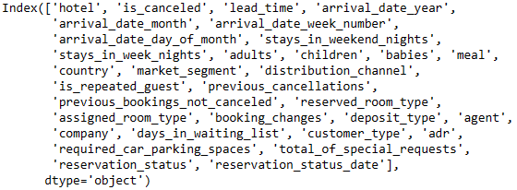



DATA EXPLORATION:
The data exploration phase involves examining the dataset's basic structure, using Pandas functions like head(), info(), and describe() to gain initial insights

Slide 10




DATA CLEANING:
Data cleaning is performed to handle missing values, duplicates, and irrelevant columns, ensuring the dataset is ready for analysis. Any inconsistencies or data quality issues are addressed during this stage.

Slide 11




DATA GROUPING:
Groupings and filtering operations are utilized to identify patterns and correlations within the dataset. This phase aims to understand hotel visiting customer types distribution, meal variations, and other relevant characteristics

Slide 12
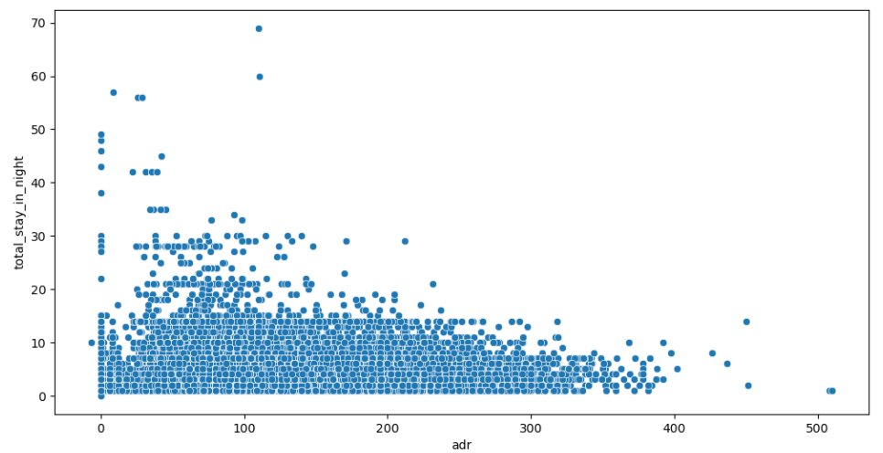
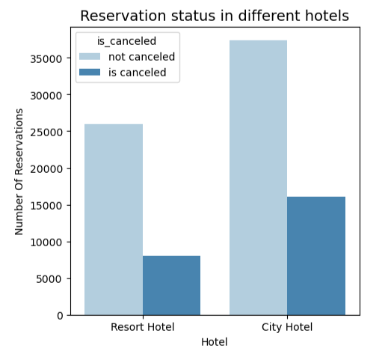
DATA VISUALISATION:
To effectively communicate the analysis results, Matplotlib and Seaborn are employed to create informative and visually appealing data visualizations. Scatter plots, bar plots, box plots, and heat maps are utilized to present the relationships and distributions of the dataset attributes. These visualizations aid in interpreting the analysis outcomes and uncovering hidden trend

Slide 13
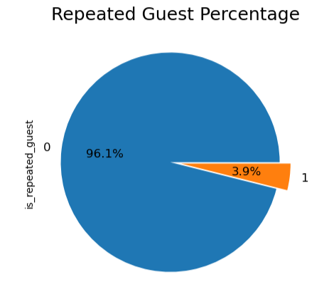
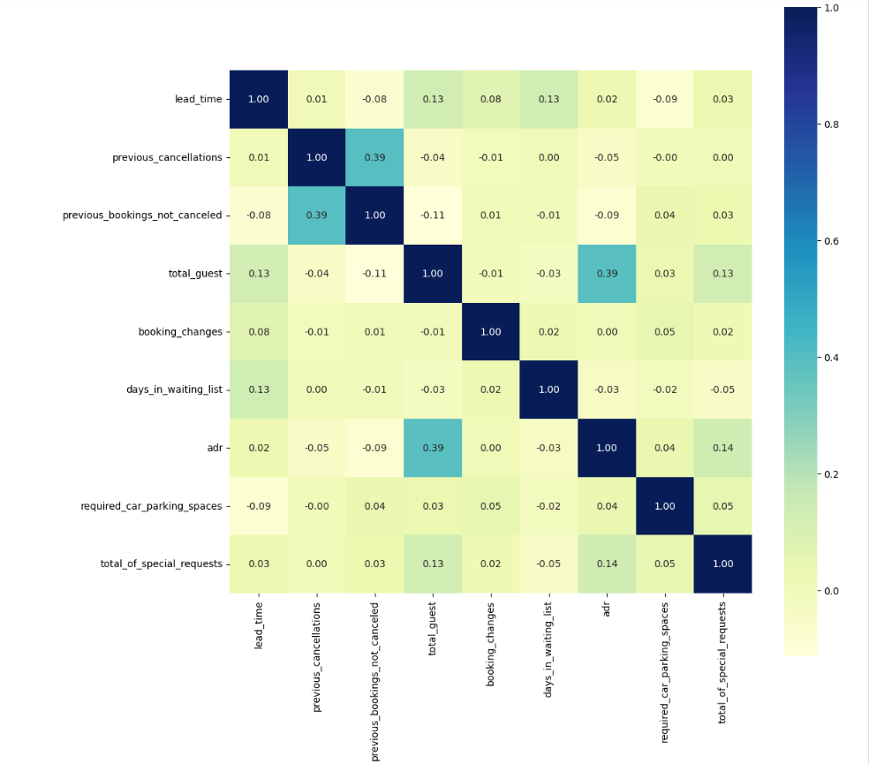
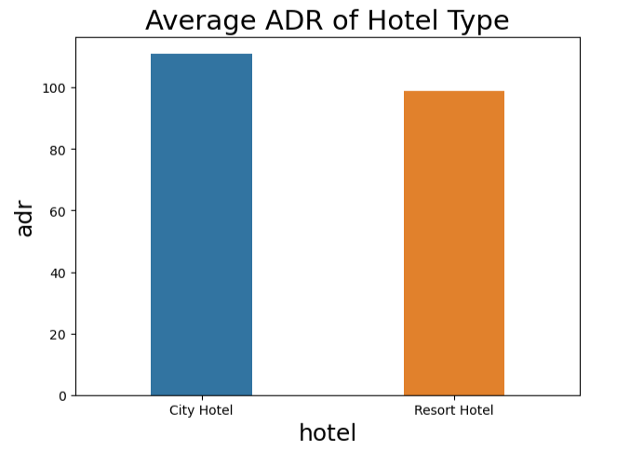
DATA VISUALISATION:

Slide 14
USES OF DATA ANALYSIS LIBRARY
PANDAS
MATPLOTLIB
SEABORN
Data Manipulation:. It allows filtering, grouping, and aggregating data to derive meaningful insights.
Handling Missing Data: Pandas' functions handle missing data points effectively, ensuring data quality and preventing biases in the analysis.
Joining and Merging: Pandas is used to combine datasets when additional information, such as customer reviews or hotel amenities, is available separately.
Data Visualization: Matplotlib allows the creation of various visualizations like line plots, bar charts, and scatter plots to depict booking trends, revenue fluctuations, and customer distribution.
Time Series Analysis: With Matplotlib, time series plots can illustrate booking patterns over specific time intervals, highlighting seasonal variations and trends.
Enhanced Data Visualization: Seaborn is built on top of Matplotlib and offers more aesthetically pleasing and informative visualizations. It simplifies the creation of complex plots like heatmaps, pair plots, and violin plots.
Categorical Data Visualization: It excels at visualizing categorical data, such as room types or customer nationalities, using bar plots or box plots, which aids in understanding preferences and trends.

Slide 15
ADVANTAGES
Versatility and Flexibility:
Python, as a programming language, is highly versatile and flexible, allowing easy integration with various data sources and formats. This enables hoteliers to analyze data from different booking platforms and internal databases seamlessly.
Rich Data Analysis Libraries:
Pandas, Matplotlib, and Seaborn provide a comprehensive suite of data manipulation, visualization, and statistical functions. Their extensive capabilities empower analysts to perform complex data analysis and generate informative visualizations with relative ease.

Slide 16
ADVANTAGES
Data Visualization:
Matplotlib and Seaborn excel at creating visually appealing and informative plots, charts, and graphs. These visualizations enhance the presentation of complex data, making it easier for stakeholders to understand trends, patterns, and correlations.
Data-Driven Decision Making:
By analyzing booking patterns, customer preferences, and revenue trends, hotel management can make data-driven decisions to optimize pricing, marketing strategies, and operational efficiency. This leads to better resource allocation and improved customer experiences.

Slide 17


CONCLUSION
In conclusion, the hotel booking analysis using Python, Matplotlib, Pandas, and Seaborn has yielded valuable insights that hold significant implications for the hotel's success and competitiveness in the hospitality industry
In summary, the hotel booking analysis using python,matplotlib,pandas ans seaborn equips the hotel with actionable insights for making informed decisions.
The integration of data analytics into hotel core operations will be a driving force in maintaining a competitive edge and achieving sustainable growth in the long run .

Slide 18
THANK YOU!

